Slide 1
XLL Phishing
Utilizing Microsoft Excel Add-In’s for Initial Access

Slide 2

Whoami
Alex Reid
OSCP, OSEP, RTJC
Red Teamer and Tool Developer
~2.5 years in cyber / red teaming / development
2x contributor to CobaltStrike Community Kit
Interested in Windows malware development and exploitation
Primarily develop in C, work in Python3 / Powershell when the opportunity arises
GitHub: https://github.com/Octoberfest7

Slide 3
“Necessity is the mother of invention”
VBA Macros embedded within Office docs are well known and ubiquitous with phishing
Microsoft is FINALLY taking steps to address this attack vector
Office files containing macros obtained via email or internet are now hard-disabled:
“With this change, when users open a file that came from the internet, such as an email attachment, and that file contains macros, the following message will be displayed:”¹
1. https://learn.microsoft.com/en-us/deployoffice/security/internet-macros-blocked

Slide 4
Theory of Phishing for Access
What makes a good phishing for access vector? Considerations:
Complexity- How many steps are required by the victim?
Specificity- Is the vector architecture specific? Dependent on third-party software?
Delivery- Can it be attached to an email? Downloaded from a webserver?
Attack Surface Reduction- Application whitelisting? Network protections? Other ASR rules?
Detection- AV/EDR on endpoints?
Factors can compound; an adaptation to overcome one problem may cause another

Slide 5
Setting the stage
This research was performed with a fictional target organization in mind that employs several industry standard defensive measures:
Email filtering rules preventing dangerous file types from being received
A network proxy that blacklists certain file types from being downloaded
Application whitelisting on endpoints that limit potential payload formats
Data Loss Prevention (DLP) measures prevent mounting of external storage devices
Microsoft Defender for Endpoint (MDE) deployed and active

Slide 6
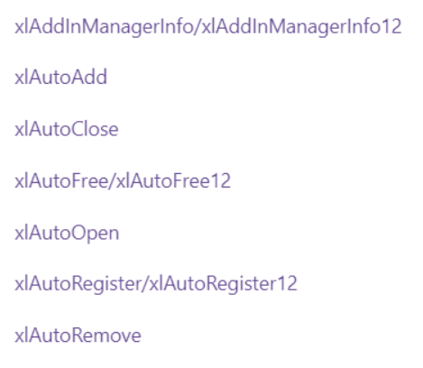
What is an Xll?
An XLL is a DLL with a special entry point that Microsoft Excel recognizes and can load
Been around since Microsoft Excel 97!
Create new user-defined functions and features in Excel
XLL’s can be written in C or C++ (and maybe C# with some extra work)

Slide 7
XLL’s and Threat actors
A quick Google search shows research back in 2017 on using XLL’s and WLL’s for persistence
Lots of articles on threat actors and APT’s utilizing XLL’s from 2020 -> present
Agent Tesla, Dridex, RedLine, Hancitor, BazaLoader, Raccoon Stealer²³⁴⁵
2. https://unit42.paloaltonetworks.com/excel-add-ins-malicious-xll-files-agent-tesla/
3. https://threatresearch.ext.hp.com/how-attackers-use-xll-malware-to-infect-systems/
4. https://isc.sans.edu/forums/diary/Hancitor+tries+XLL+as+initial+malware+file/27618/
5. https://www.zdnet.com/article/theres-been-a-big-rise-in-phishing-attacks-using-microsoft-excel-xll-add-ins/

Slide 8
An initial inventory
Pros
XLL’s are ran by Excel; a trusted application
Excel is commonly encountered
Written in C or C++; can utilize much more robust malware TTP’s than in VBA
Cons
XLL’s aren’t commonly encountered
They are executables; MZ header
This can limit delivery options
Architecture specific; x86 XLL will NOT run in x64 Excel!

Slide 9
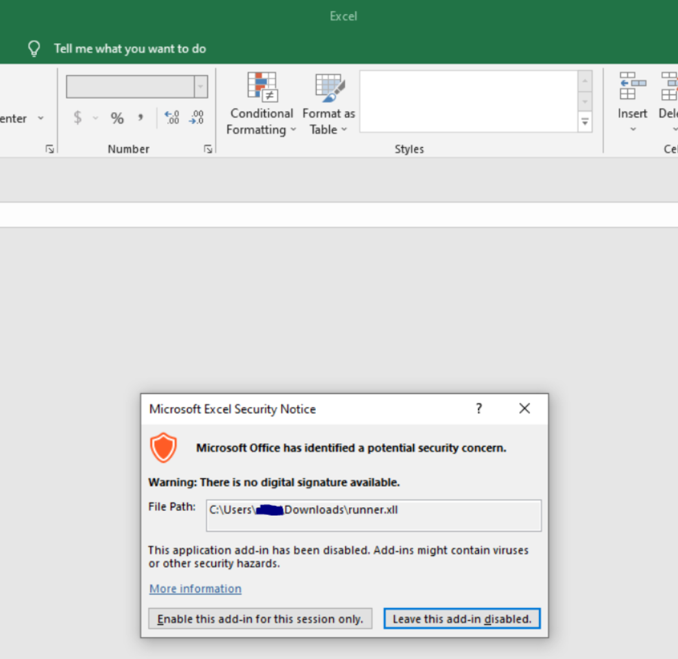
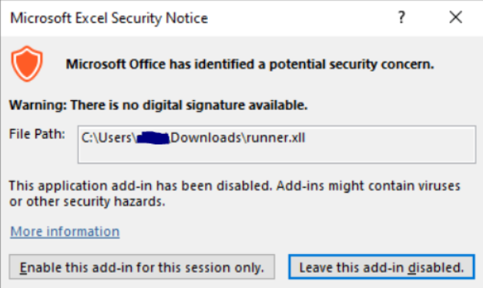
How to execute?
File explorer / Desktop: Just double click!
One dialogue stands between user and code execution

Slide 10
Delivery methods
Email Attachment:
Organizations and email clients have very robust protections nowadays
Example rules:
Block executable attachments (EXE, DLL, XLL, etc)
Block certain container files (ISO, IMG, etc)
Examine ZIP files and block those containing executables
Block password protected ZIP’s
No good…

Slide 11
Delivery methods
Web Delivery
Less ideal; email target with a link to your webserver to pull down hosted XLL
Domain reputation? Network proxy?
Blocked file types? Executables (EXE, DLL, XLL, etc) still aren’t allowed…
What about containers? Rules may be different than those applied to emails
(Notional) Success!
ISO/IMG are still no good due to DLP; ZIP’s are allowed!
Wait… Executables are blocked, but executables in ZIP’s are allowed?
Defensive policies can be peculiar; poke and prod and you might just find a way

Slide 12
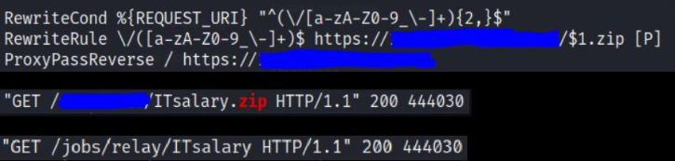
Delivery Methods
A sneaky side-bar…
Network inspection of traffic leaving an organization can raise eyebrows
Someone is downloading a zip (from an obscure domain)? What is it?
Utilize Apache mod_rewrite to modify traffic on the redirector
Phishing link in email: https://mydomain.com/jobs/relay/ITsalary
GET request modified on redirector -> https://mydomain.com/jobs/relay/ITsalary.zip
Doesn’t look like a request for a ZIP leaving victim network, but they receive a ZIP

Slide 13
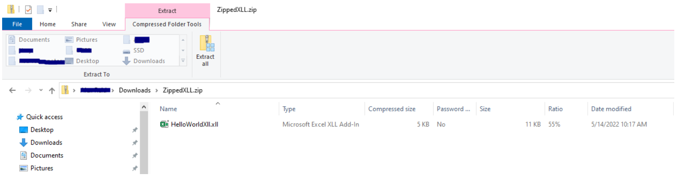
Zip files and execution
ZIP’s are a strong choice because:
Natively compatible with Windows
Can be downloaded from the internet by our organization
Add little complexity to the attack
Victim’s can click the ZIP file in the browser download bar and file explorer will open it up:

Slide 14
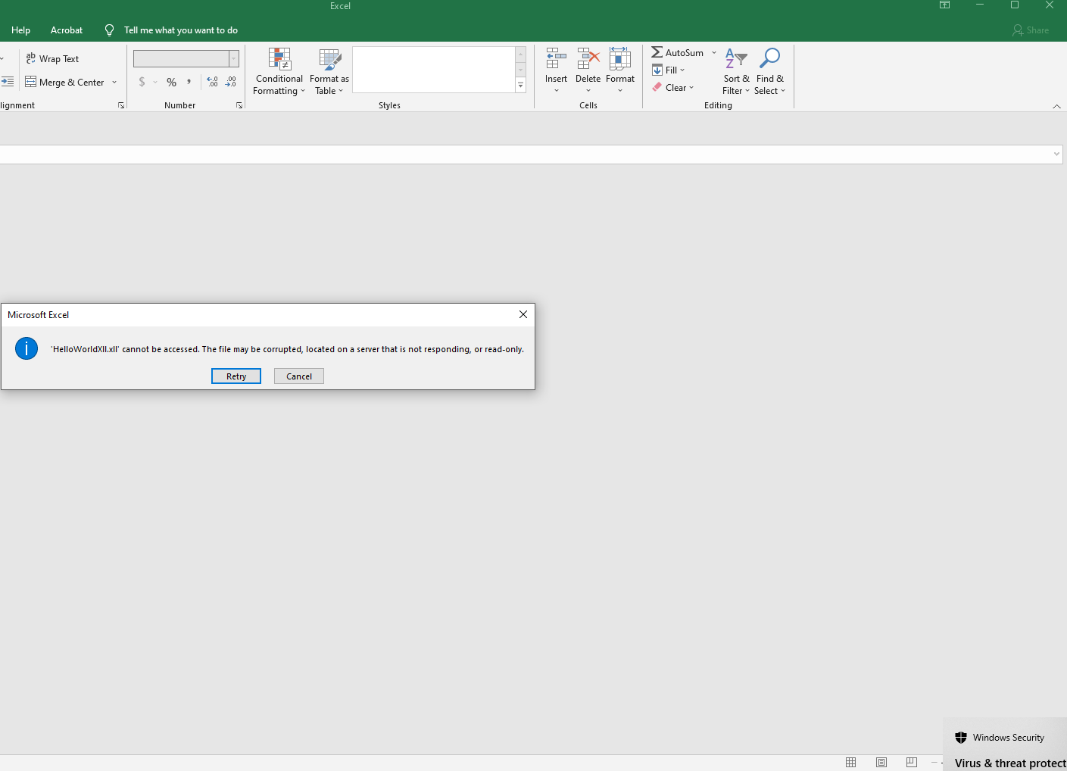
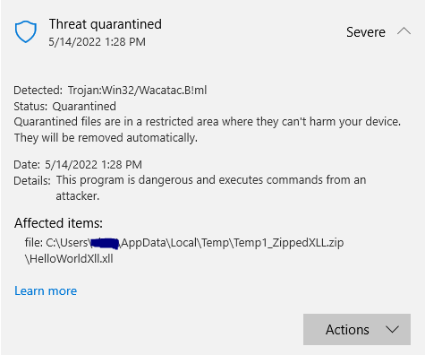
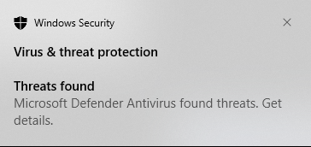
Trouble in paradise

Slide 15
Zip files and execution
Path of the “malicious” file is strange…
XLL was in c:\Users\user\Downloads\ZippedXLL.zip
Defender said it was C:\Users\user\AppData\Local\Temp\Temp1_ZippedXLL.zip\HelloWorldXLL.xll
This is ZIP behavior, not XLL behavior:
When a file in a ZIP archive is opened without having been extracted, it is copied to AppData\Local\Temp
Defender seems to have a signature for ANY code execution in the Temp folder… not a bad idea

Slide 16
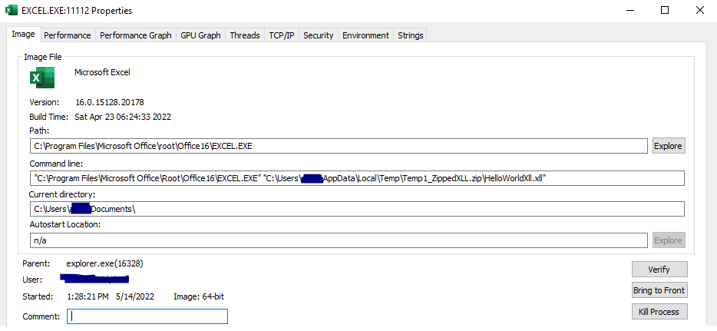
Zip files and execution

Slide 17
A rock and a hard place…
ZIP’s allow victims to download XLL from web
Executing XLL from within ZIP copies it to AppData\Local\Temp + flags AV
XLL executes without flagging AV if extracted first
Can we rely on victim to do so?
Again other containers (ISO, IMG) won’t work due to DLP
How can we utilize ZIP’s but avoid Defender flagging execution of the XLL?
Remember earlier about poking and prodding?

Slide 18
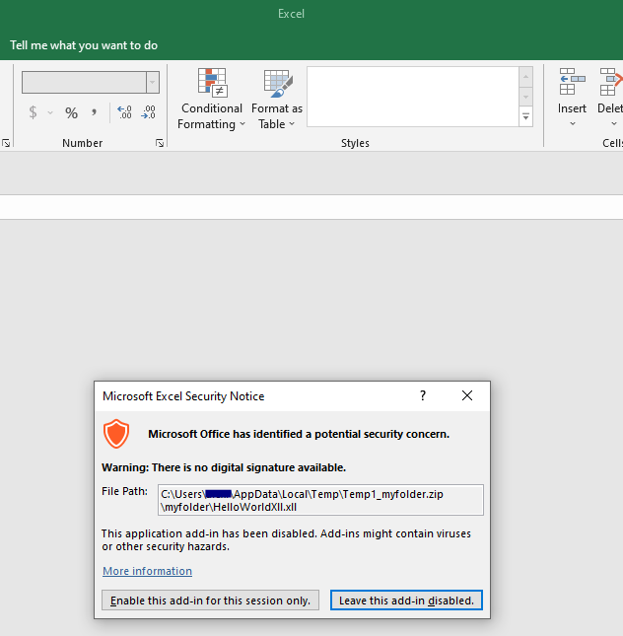
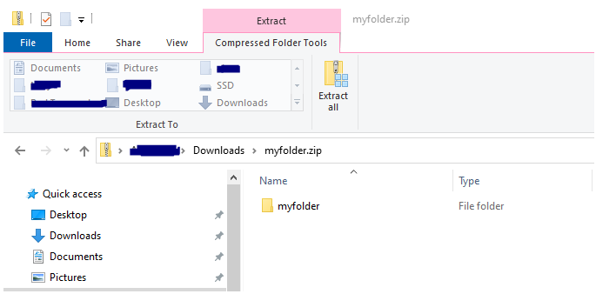
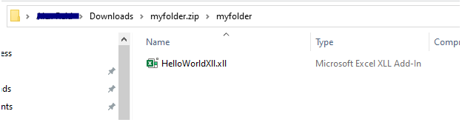
One step to the right
What if we stick the XLL inside a folder?

Slide 19
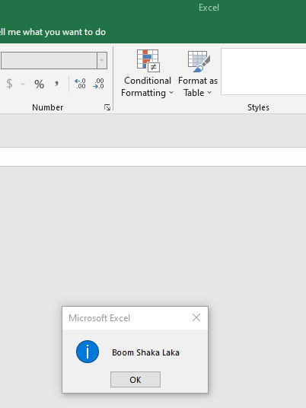
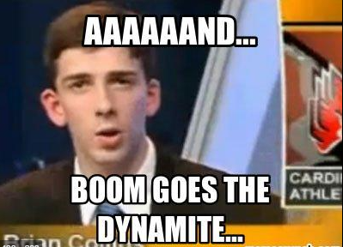
Success!

Slide 20

Tradecraft
We have code execution… now what?
Goals:
Run our implant
Avoid suspicion from the victim
Clean up the XLL

Slide 21
Executing the implant
To reiterate, XLL’s are C/C++; SO much you can do when it comes to malware
Utilize all the standard tips and tricks
Encode/Encrypt shellcode within the XLL
Sandbox detection/evasion
API hashing, direct syscalls, refresh NTDLL, etc.
Scope checks to ensure XLL only executes within target network (Domain, IP, etc)
Critically:
Utilize an execution method that will run your implant in another process!
Victim can close Excel immediately after it opens and we are ok!

Slide 22
Tricking the victim
Pretexting led the victim to download and run the XLL
“Please see the spreadsheet containing…”
Even after execution we prefer that the victim doesn’t suspect anything
Embed an XLSX as a byte-array in our XLL
When the XLL executes, it runs our implant and then drops the XLSX to disk
Call CreateProcess on Excel + the XLSX and it opens to the screen

Slide 23
Cleaning up
If possible, prevent re-infection and remove XLL to make incident response more difficult / protect tooling
Great project from LloydLabs: https://github.com/LloydLabs/delete-self-poc
Allows a running program to delete itself from disk; usually impossible because file is locked.
Can utilize this code to delete XLL (AppData\Local\Temp) AND the original ZIP
In addition to embedded XLSX, embed a new ZIP containing the XLSX

Slide 24
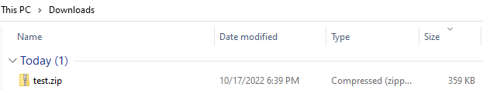
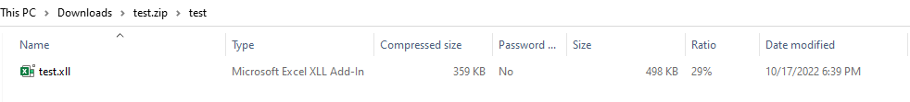
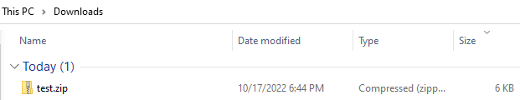
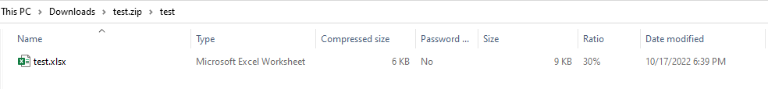
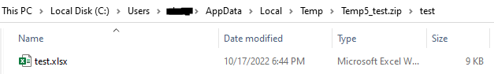
Before:
After:

Slide 25

Demo time!

Slide 26
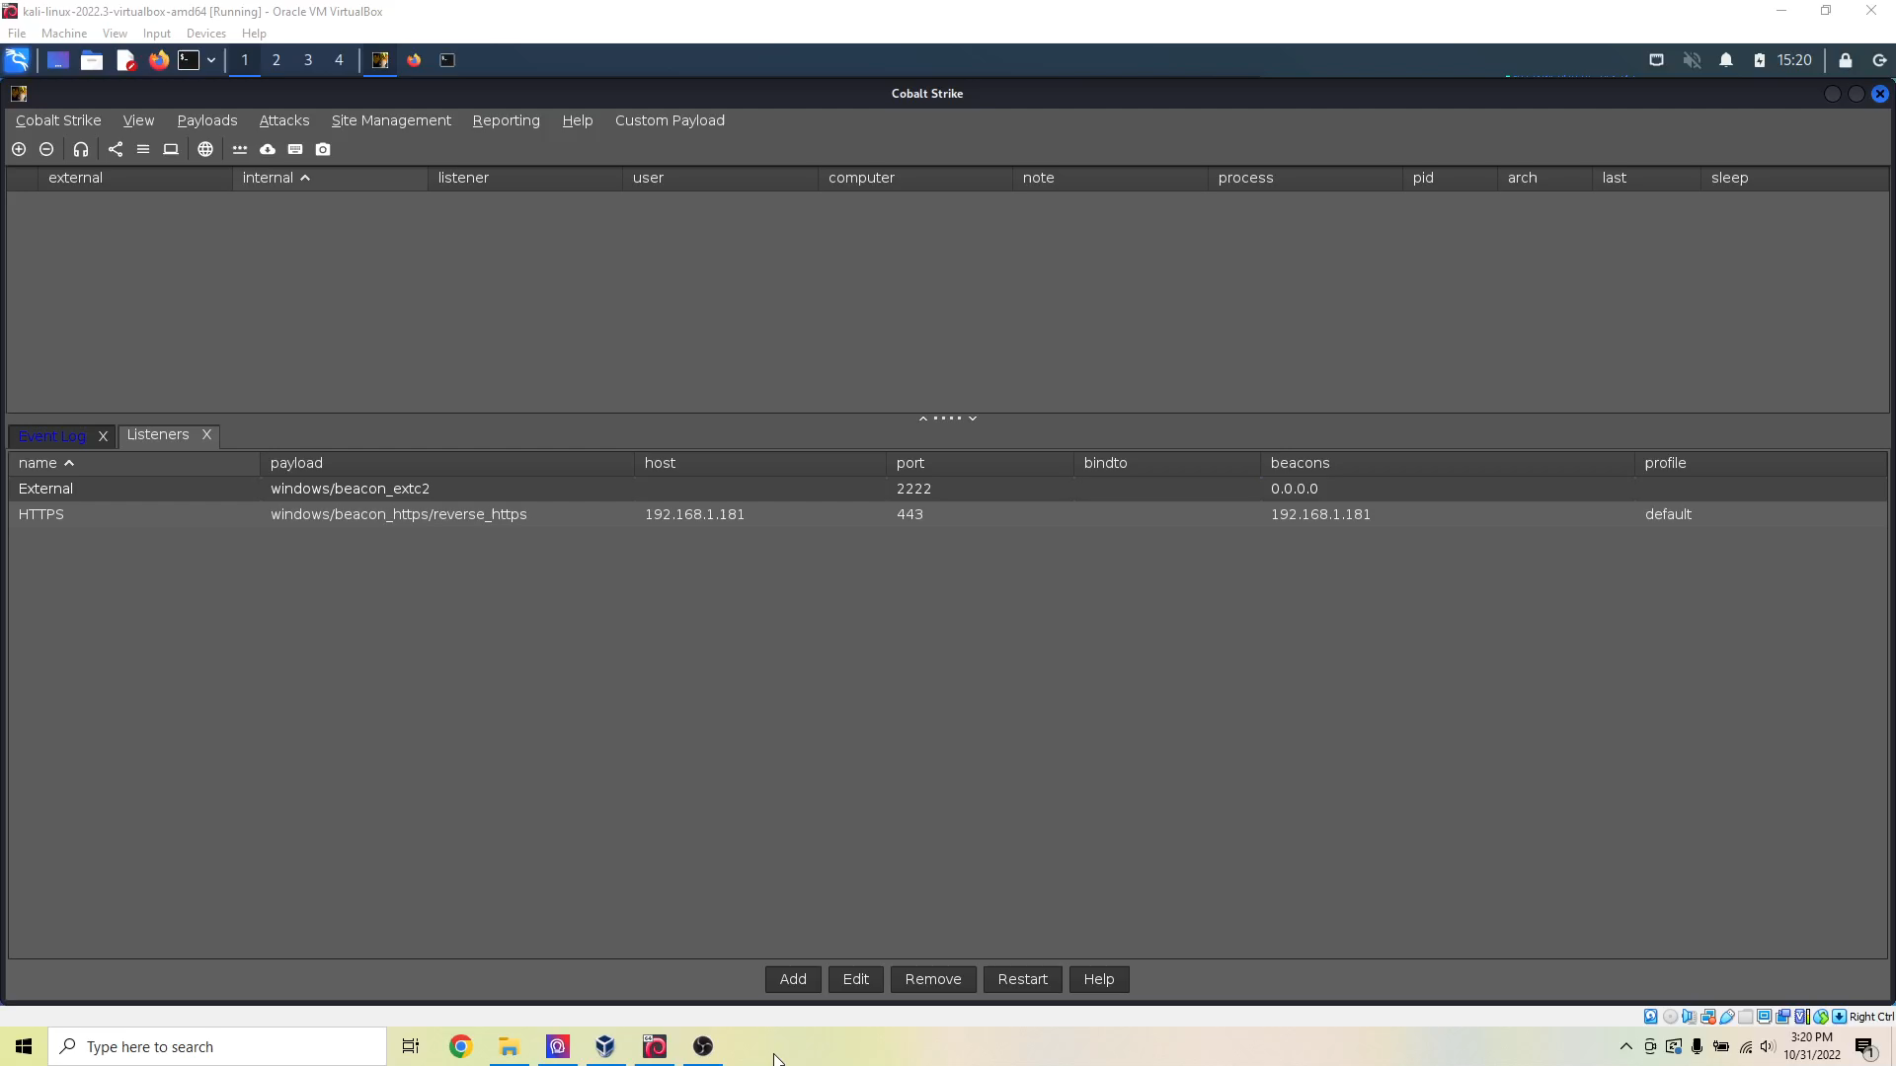

Slide 27
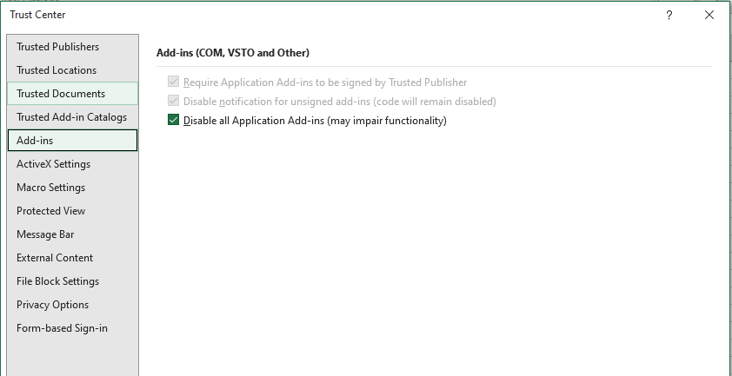
Mitigation
How can organizations protect themselves from XLL’s?
Excel Trust Center
While this sure looks like it should stop XLL’s
(Add-ins) from running, it doesn’t!
This setting appears to relate to loading or
registering Add-ins the intended way through
Excel; double-clicking XLL’s still works!

Slide 28
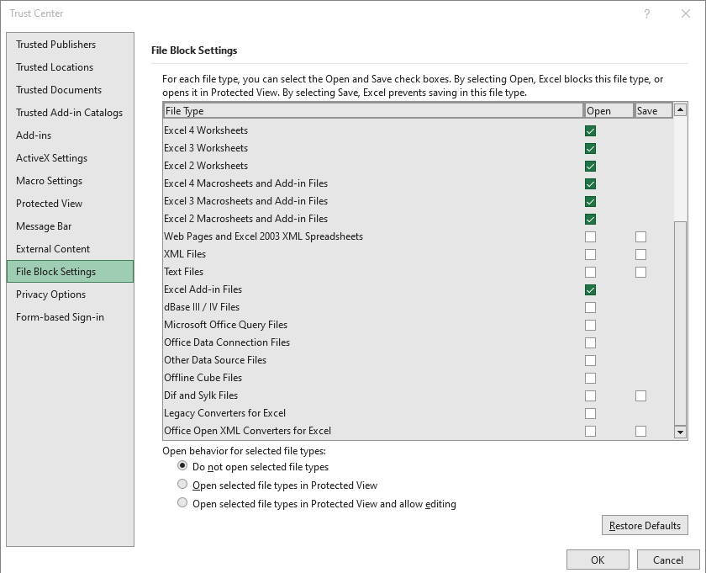
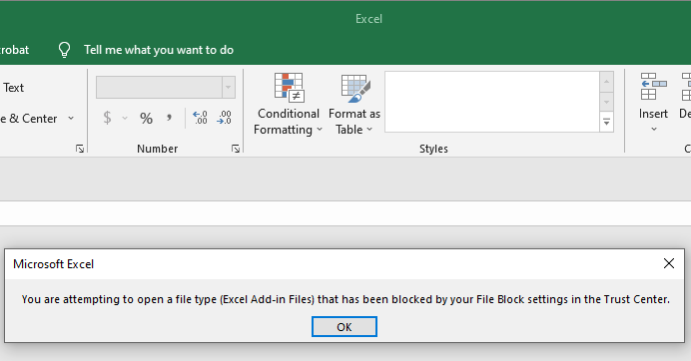
The nuclear option
Also in Excel Trust Center
Utilizing File Block Settings, XLL’s will now fail to execute when double-clicked

Slide 29
Except…
Trust Center apparently doesn’t apply to Office called via automation…
Using COM objects we can still execute XLL’s!
Demo Time!

Slide 30


Slide 31
Questions?
Resources:
HelloWorldXll by edparcell: https://github.com/edparcell/HelloWorldXll
PackMyPayload by mgeeky: https://github.com/mgeeky/PackMyPayload
delete-self-poc by LloydLabs: https://github.com/LloydLabs/delete-self-poc
Full write-up available at: https://github.com/Octoberfest7/XLL_Phishing

